Slide 1

REVIEW FOOD DÍT VỪA KHÍT
Here is where your presentation begins

Slide 2

TIMELINE
Week 1 - 2
Week 3 - 5
Week 6 - 10
Page establishment, create idea.
Basic details: share food, share address, review
Posting Page.

Slide 3
Week | No. | Work | Who | Deadline | Note
1-2 | 1 | Dicuss idea project | All of team | 3/6 | Logo, logan, direction projection,…..
 | 2 | Create Logo | Ngọc | 6/6 | Change 7/6
 | 3 | Building page on Facebook | Tâm and Nguyệt | 8/6
 | 4 | Proposal | All of team | 27/6
3-5 | 5 | Sustentive page | All of team | …..
 | 6 | First post - Page introduction - Explain and purpose | Nguyệt and Tâm | 8/6 | Create an image for the intro, include the name of the page's slogan, and post it on the page.
 | 7 | Post1:#bundau | Tâm | 22/6 | Time, price, address, review food.
 | 8 | Post2:#banhtrang | Thảo | 23/6 | Time, price, address, review food.
 | 9 | Post3:#chequan9 | Ngân | 24/6 | Time, price, address, review food.
 | 10 | Post4:#chethuduc | Ngọc | 25/6 | Time, price, address, review food.

Slide 4
Week | No | Work | Who | Deadline | Note
 | 11 | Post5:#bunbo | Ngọc | 30/6 | Time, price, address, review food.
Week 6 - 9 | 12 | Post6:#banhcuon | Tâm | 13/7 | Time, price, address, review food.
 | 13 | Post7:#banhcanhcua | Thảo | 16/7 | Time, price, address, review food.
 | 14 | Post8:#oc | Nguyệt | 20/7 | Time, price, address, review food.
 | 15 | Post9:#banhxeo | Ngân | 22/7 | Time, price, address, review food.
 | 16 | Post10:#comga | Tâm | 25/7 | Time, price, address, review food.
 | 17 | Post11:#banhmi | Ngọc | 28/7 | Time, price, address, review food.
 | 18 | Post12:#xoi | Ngân | 30/7 | Time, price, address, review food.
 | 19 | Post13:#bone | Thảo | 2/8 | Time, price, address, review food.
 | 20 | Post14:#banhcan | Nguyệt | 4/8 | Time, price, address, review food.
 | 21 | Post15:#quannhau | All of member | 7/8 | Time, price, address, review food.

Slide 5
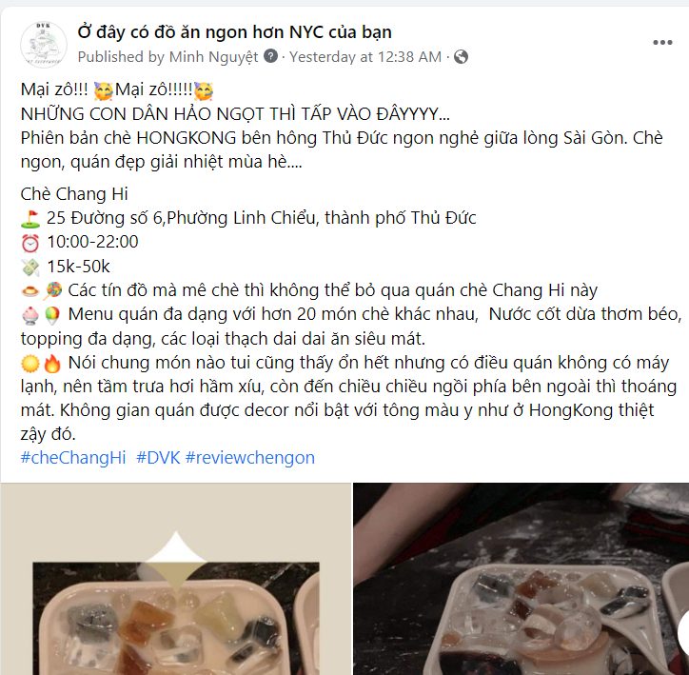
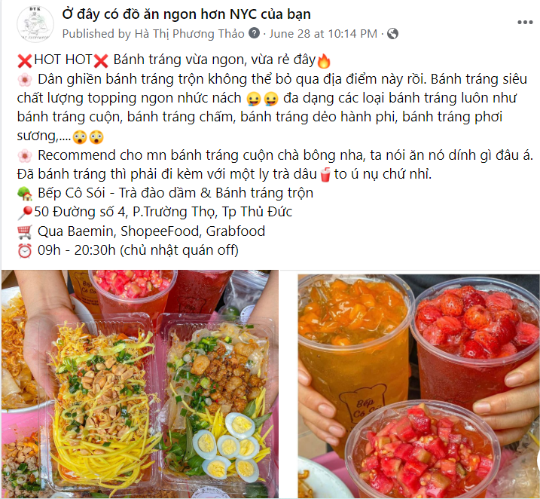
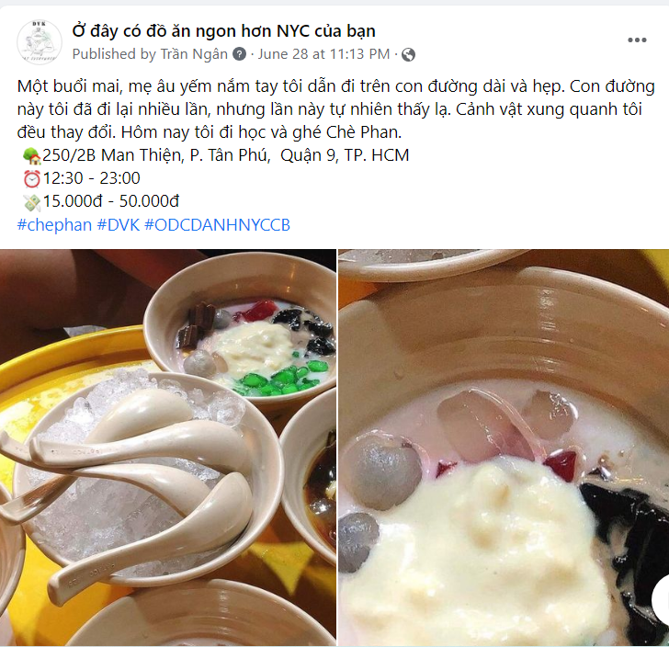
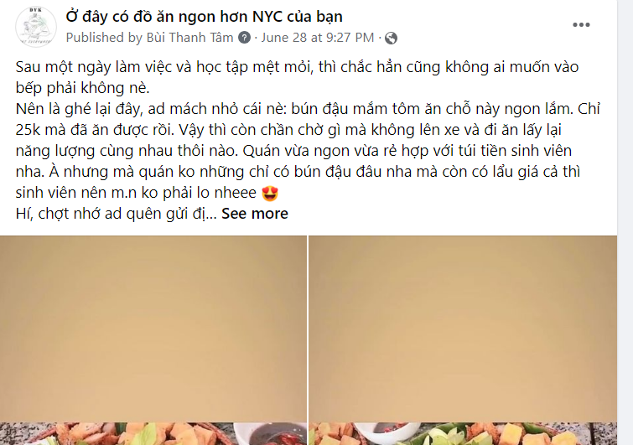

Slide 6
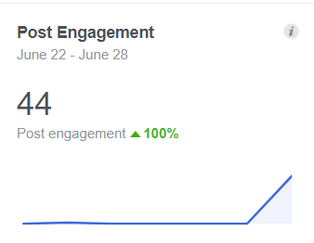
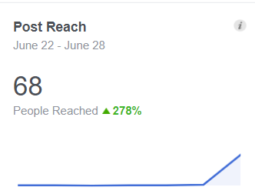
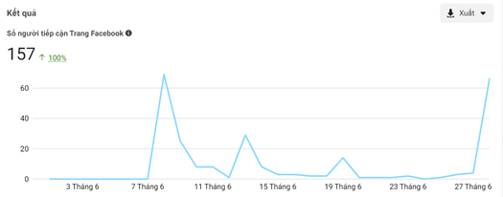
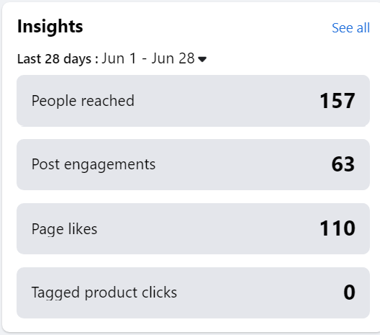
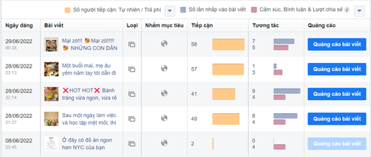

Slide 7

ADVANTAGE

Slide 8

DISADVANTAGE

Slide 9


THANK YOU

